Slide 1
AGENDA SUMMARIZATION FROM SPEECHES BY POLITICIANS
Group 11:
Gaurav Shinde
Shahbaz Mansahia
Jay Bharadva

Slide 2
PROBLEM WE ARE TRYING TO SOLVE
We have one big problem plaguing virtually all political systems , i.e. lies and a lack of confidence in their representatives.
This is a problem across the board and is fodder for most news publications.
We are going to attempt to summarize speeches by political figures to ascertain their agenda.
The larger vision of this idea is to be able to visualize and quantify the agenda of a political collective/platform/party.
Through this, the voters can be better informed about who and exactly what they are voting for.

Slide 3

With so many important topics of discussion and debates going around it becomes important to know what the views of the politicians on these topics are.
The problem that we are trying to solve is to make their views and stands on various topics clear to everyone by speech analysis.
This project will help ensure better governance, representation and will also play a role of informing the voter about the contents of each vote.
Although it will probably be far from ideal, we would end up with a clearer picture of “what we are/were promised” and “what we get”.

Slide 4
PROGRESS ROADMAP
Dataset Generation
Text Summarization
Aspect Based Opinion Mining
Data Cleaning
End
Start

Slide 5

DATASET GENERATION
We scraped through 113 web pages in total to generate our desired dataset .
We scraped through the transcript sections of different politicians speeches.
We used beautiful soup , selenium as well as scrapy for the following process.
We scraped our data from various websites like millicenter.com , marxists.com and americanrhetoric.com.
This dataset generation was quite a tedious process because of the volume of links that had to be scrapped in order to achieve the required data.

Slide 6

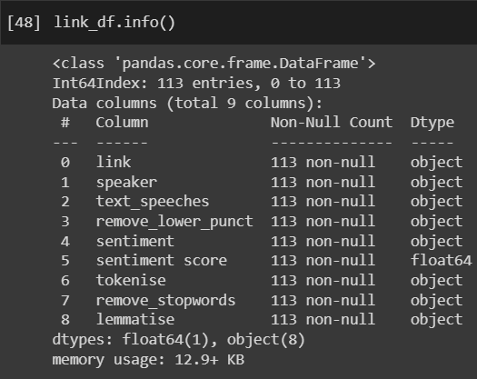
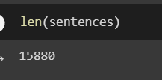
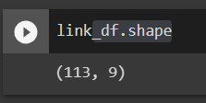
DATASET CHARACTERISTICS

Slide 7
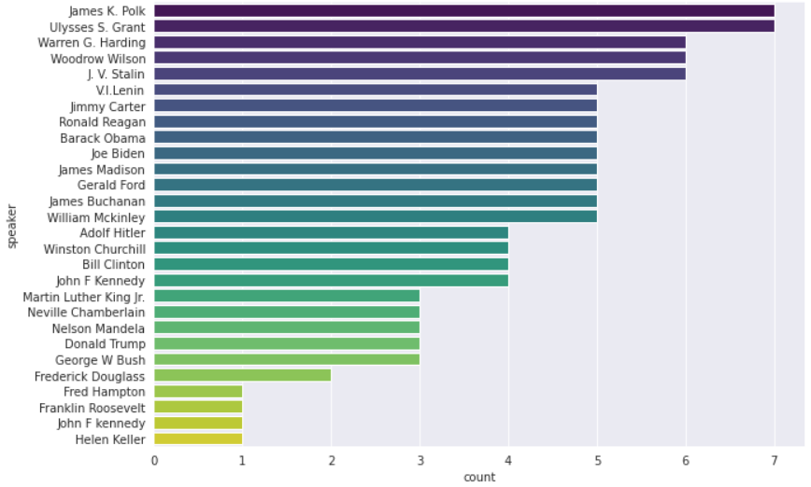

Slide 8
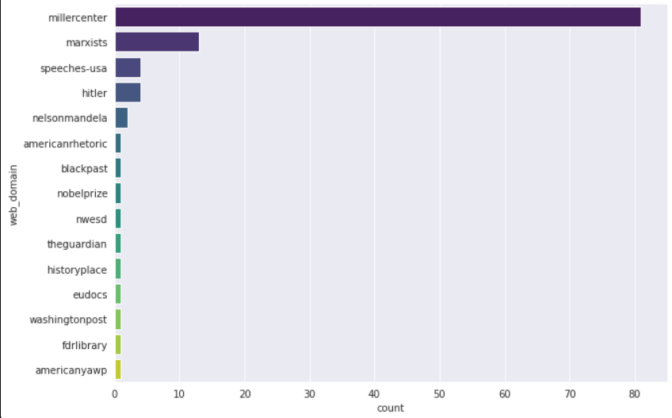

Slide 9
NLP Models and Techniques
Text Scrapers + Parser
Text Summarizer
Text Scrapers + Parser
Text Scrapers + Parser
Notes:
Shahbaz

Slide 10
NLP Models and Techniques
Aspect Based Sentiment Analysis
Text Summarizer
Notes:
Shahbaz

Slide 11
NLP Models and Techniques
Text Summarizer
Spacy
Keywords and POS tagging
Frequency Counter
Sentence “strength”
Selected Sentences
Notes:
Shahbaz

Slide 12
NLP Models and Techniques
Aspect Based Sentiment Analysis
Tokenize
Lemmatize
Vectorize (Count)
Latent Dirichlet Allocation (LDA)
Get dominant topics + relevancy score
Get Sentiment on Topic
Notes:
Shahbaz

Slide 13
Experiments Conducted
Ran model on entire corpus
Ran model on speaker-by-speaker basis (better)
Ran with and without summarized speeches
Notes:
Shahbaz

Slide 14
Insights
Summaries do make a difference to what topics are selected
Some places have errant topics like “let us” (Frederick Douglass)
Other speeches have too many local references (“United States” in presidential speeches)
Need much more data for better analysis
Notes:
Shahbaz

Slide 15
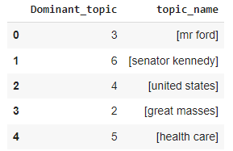
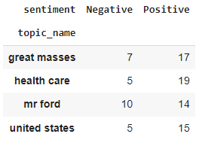
Results
Opinion Mining On Entire Corpus:

Slide 16
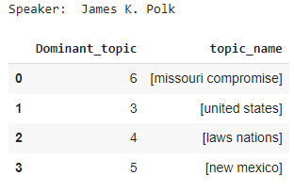
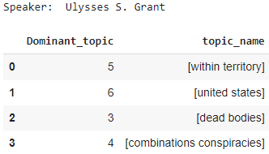
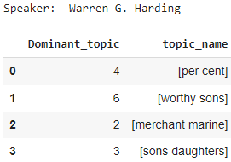
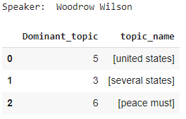
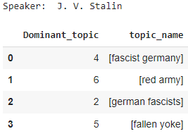
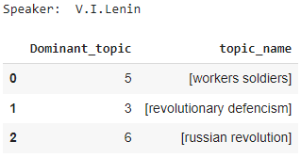
Results
Speaker by Speaker Opinion Mining:

Slide 17
Conclusion
Topic modeling can be used for aspect based opinion mining.
Gathered data, created a dataset based on the speaker and speeches from different domains.
Cleaned the dataset by removing the punctuation marks, stop words, removed unnecessary hyperlinks, and converted text speeches to lowercase.
Used LDA and extracted dominant topic by calculating relevance score for each topic.
Provided speeches count with their sentiment on each dominant topics.
Revised the data pipeline for speaker-by-speaker opinion mining.

Slide 18
Future Plans
Dataset
– More speeches per leader
– More Leaders
– Fair Distribution
– More feature (Ex. Political Affiliation, timeline)

Slide 19
References
Dataset Extraction:
[1]“Presidential Speeches | Miller Center,” Miller Center, May 03, 2017. https://millercenter.org/the-presidency/presidential-speeches
‌[2]pabitra_data arvindpdmn, “Aspect-Based Opinion Mining,” Devopedia, Nov. 15, 2019. https://devopedia.org/aspect-based-opinion-mining#qst-ans-1 (accessed Dec. 05, 2022).
‌[3]“Marxists Internet Archive Library, Complete Index of Writers,” www.marxists.org. https://www.marxists.org/archive/
[4]“New and Featured Products from Educational Video Group, Inc.,” www.evgonline.com. https://www.speeches-usa.com/Transcripts (accessed Dec. 05, 2022).
[5]“Hitler’s Speeches,” hitler.org. https://hitler.org/speeches/
[6]L. Williams, “Sentiment Analysis: Aspect-Based Opinion Mining,” Medium, Oct. 27, 2020. https://towardsdatascience.com/%EF%B8%8F-sentiment-analysis-aspect-based-opinion-mining-72a75e8c8a6d
‌
‌
‌

Slide 20
Any Questions?
Thank You !

